Slide 1
Complexity of conventional Sorting Algorithms
Course Code: CSC2211
Course Title: Algorithms
Dept. of Computer Science
Faculty of Science and Technology
Lecturer No: |  | Week No: |  | Semester:
Lecturer: | NymeAhmed (nyme.ahmed@aiub.edu)

Slide 2
Lecture Outline
1. Sorting Algorithms
Insertion Sort
Selection Sort
Bubble Sort

Slide 3
Sorting
Simple sorting methods use roughly n * n comparisons
Insertion sort
Selection sort
Bubble sort

Slide 4
Insertion Sorting
Mark first element as sorted,
Next for each unsorted element
'extract' the element
for i = last Sorted Index to 0
if current SortedElement > extracted Element
move/shift sorted element to the right by 1
else: insert extracted element

Slide 5
Insertion Sorting
To sort array A[0..n-1], sort A[0..n-2] recursively and then insert A[n-1] in its proper place among the sorted A[0..n-2]
Usually implemented bottom up (non-recursively)
Example: 6, 4, 1, 8, 5 6 | 4 1 8 5
4 6 | 1 8 5
1 4 6 | 8 5
1 4 6 8 | 5
1 4 5 6 8

Slide 6

Time Complexity of Insertion Sort (Worst Case)
= C₁n + (C₂ + C₃ + C₇) (n-1) + C₄ + (C₅ + C₆)
( )
= C1n + (C2 + C3 + C7) (n-1) + C4 $\left(\frac{n^{2}+n}{2}−1\right)$+ (C5 + C6)
$\left(\frac{n^{2}+n}{2}−n\right)$
= O (n²)
for j = 2 to A.length
key = A[j]
// Insert A[j] into A[1..j-1]
i = j-1
while (i>0 and A[i]>key)
A[i+1]=A[i]
i--
A[i+1]=key
cost c₁
c₂
0
c₃
c₄
c₅
c₆
c₇
times n n-1 n-1 n-1 n-1

Slide 7

Time Complexity of Insertion Sort
For worst case: O (n²)
For average case: $θ$(n²)
For best case: Ω (n)

Slide 8
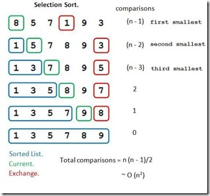
Selection Sorting
Concept for sort in ascending order:
Locate smallest element in array. Exchange it with element in position 0
Locate next smallest element in array. Exchange it with element in position 1.
Continue until all elements are arranged in order
Min value | Min Index
8 | 0
5 | 1
1 | 3
5 | 1
3 | 5
7 | 2
5 | 5
8 | 3
7 | 5
9 | 4
8 | 5

Slide 9
Time Complexity of Selection Sort (Worst Case)
= C₁n + (C₂+C₆+C₇+C₈) (n – 1) + C₃ x n (n – 1) + (C₄+C₅) (n-1)²
= C₁n + (C₂+C₆+C₇+C₈) (n – 1) + C₃(n² – n) + (C₄+C₅)(n²-2n+1)
= O (n²)
Cost Times
for (i=0;i<n-1;i++) C₁ n
{
key = I; C₂ (n-1)
for (j=i+1;j<n;j++) C₃ (n-1)n
if(list[k]>list[j]) C₄ (n-1)(n-1)
{
k=j; C₅ (n-1)(n-1)
}
tempval=list[i]; C₆ (n-1)
list[i]=list[k]; C₇ (n-1)
list[k]=tempval; C₈ (n-1)
}

Slide 10

Time Complexity of Selection Sort
For worst case: O (n²)
For average case: $θ$(n²)
For best case: Ω (n²)

Slide 11
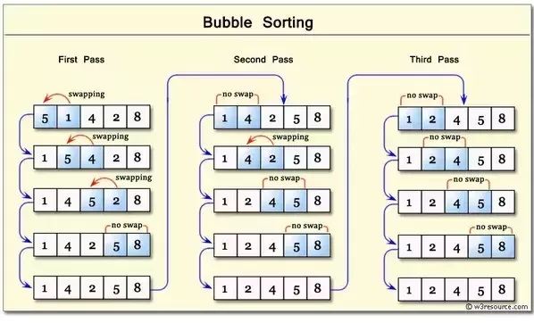
Bubble Sorting
Concept:
Compare 1st two elements
If out of order, exchange them to put in order
Move down one element, compare 2nd and 3rd elements, exchange if necessary. Continue until end of array.
Pass through array again, exchanging as necessary
Repeat until pass made with no exchanges.

Slide 12
Time Complexity of Bubble Sort (Worst Case)
Cost Times
int i, j, temp;
bool swapped;
for(i=0;i<n-1;i++) { C₁ n
swapped = false; C₂ (n-1)
for(j=0;j<(n-i-1);j++) { C₃ (n-1)n
if( a[j]>a[j+1] ) { C₄ (n-1)(n-1)
temp = a[j]; C₅ (n-1)(n-1)
a[j] = a[j+1]; C₆ (n-1)(n-1)
a[j+1] = temp; C₇ (n-1)(n-1)
swapped = true;} C₈ (n-1)(n-1)
}
if (!swapped) C₉ n-1
{ break; } C₁₀ n-1
}

Slide 13
Time Complexity of Bubble Sort
For worst case: O (n²)
For average case: $θ$(n²)
For best case: Ω (n)

Slide 14
Books
Introduction to Algorithms, Thomas H. Cormen, Charle E. Leiserson,
Ronald L. Rivest, Clifford Stein (CLRS).
Fundamental of Computer Algorithms, Ellis Horowitz, Sartaj Sahni, Sanguthevar Rajasekaran (HSR)

